Slide 1

Diabetes Prediction in Female Patients
Sucharitha Puppala
Data Science, Bellevue University.
DSC680-T301 Applied Data Science (2233-1)
Professor Catherine Williams.
January 8,2023

Slide 2
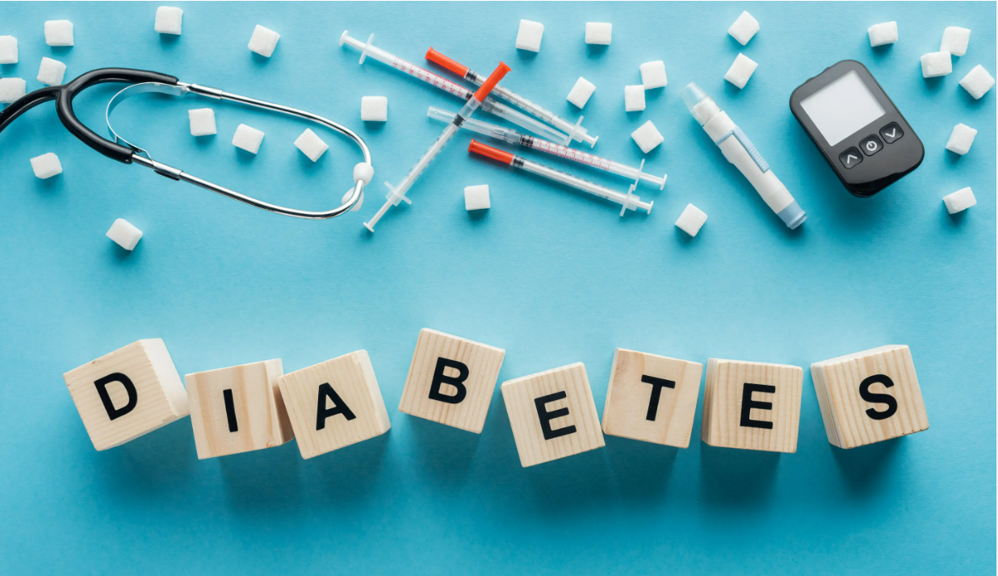
Introduction
Diabetes is a chronic (long-lasting) health condition that affects how your body turns food into energy.

Slide 3
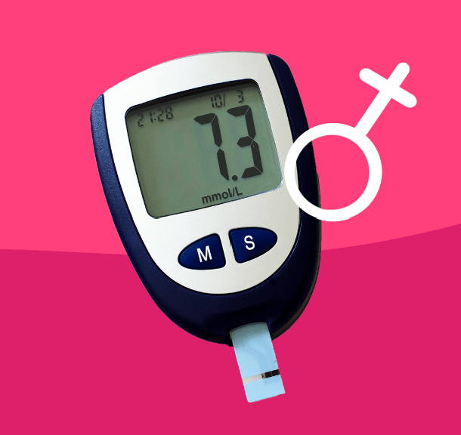
Diabetes in Females
Diabetes can look and feel different for women. Identifying and treating the unique symptoms and risks of women with diabetes may lead to a better quality of life.

Slide 4
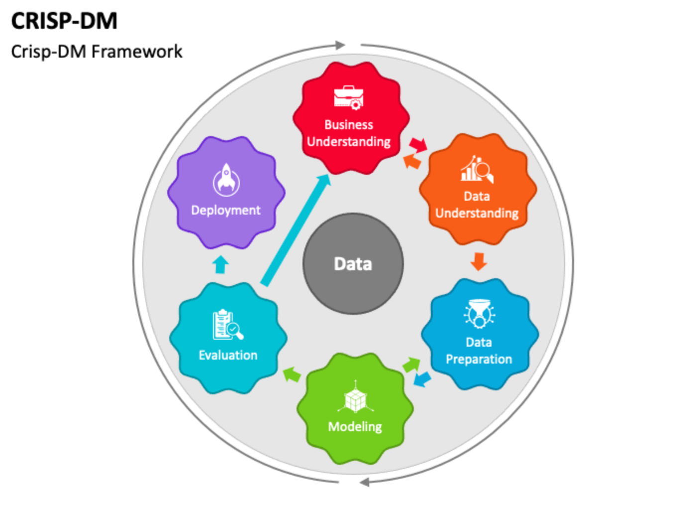
Methodology
CRISP-DM stands for cross-industry process for data mining. The CRISP-DM methodology provides a structured approach to planning a data mining project. It is a robust and well-proven methodology.

Slide 5
Business Understanding
Diabetes is one of the biggest health problems that affect millions of people across the world. Uncontrolled diabetes can increase the risk of heart attack, cancer, kidney damage, blindness, and other illnesses.
Researchers are motivated to create a Machine Learning methodology that can predict diabetes in the future. Exploiting Machine Learning Algorithms (MLA) is essential if healthcare professionals are able to identify diseases more effectively.
In order to improve the medical diagnosis of diabetes this research explored and contrasts various MLA that can identify diabetes risk early.
The project mainly focuses on the Prediction of diabetes in female patients.

Slide 6
Data Understanding 1. Dataset Source
The dataset used for this project is collected from Kaggle.com.
The dataset is originally from the National Institute of Diabetes and Digestive and Kidney Diseases. The data in the dataset is related to all female patients.
Variables in the dataset
Pregnancies: To express the Number of pregnancies
Glucose: To express the Glucose level in blood
BloodPressure: To express the Blood pressure measurement
SkinThickness: To express the thickness of the skin
Insulin: To express the Insulin level in blood
BMI: To express the Body mass index
DiabetesPedigreeFunction: To express the Diabetes percentage
Age: To express the age
Outcome: To express the final result 1 is Yes and 0 is No

Slide 7
Data Understanding 2. Overview of the dataset
Shape of the dataset -> 786 rows and 9 columns
The dataset contains only numerical variables.
The target variable is ‘Outcome’ that is having diabetes or not.
There are no null values and duplicate values in the dataset.

Slide 8
Data Understanding 3.Data Exploration
For the exploratory data analysis the following visualizations are used.
Bar plots
Histograms
Boxplot
Pair plot
Heat map

Slide 9
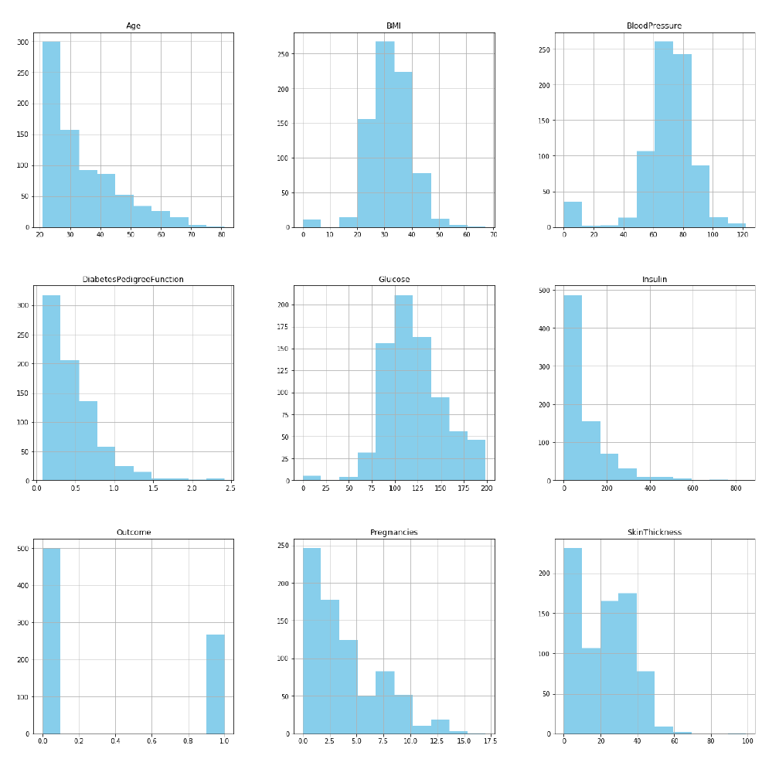
Data Understanding 3.Data Exploration
Histogram of the numerical variables of the dataset.

Slide 10
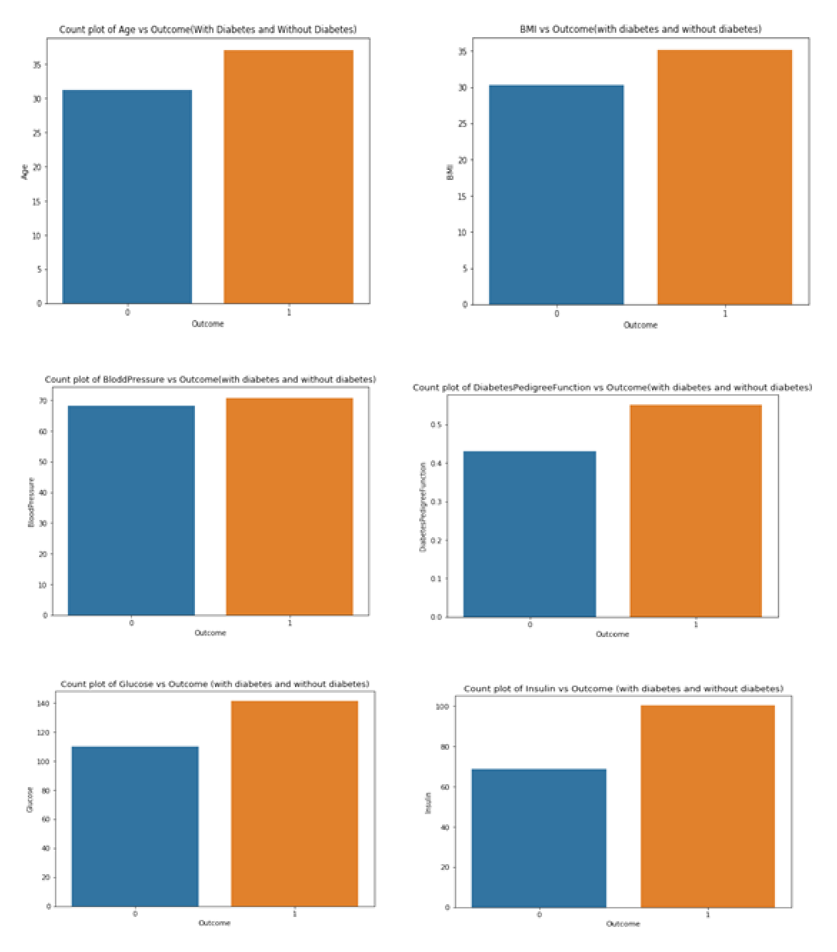
Data Understanding 3.Data Exploration
Count plots of the features of the dataset with the target variables

Slide 11
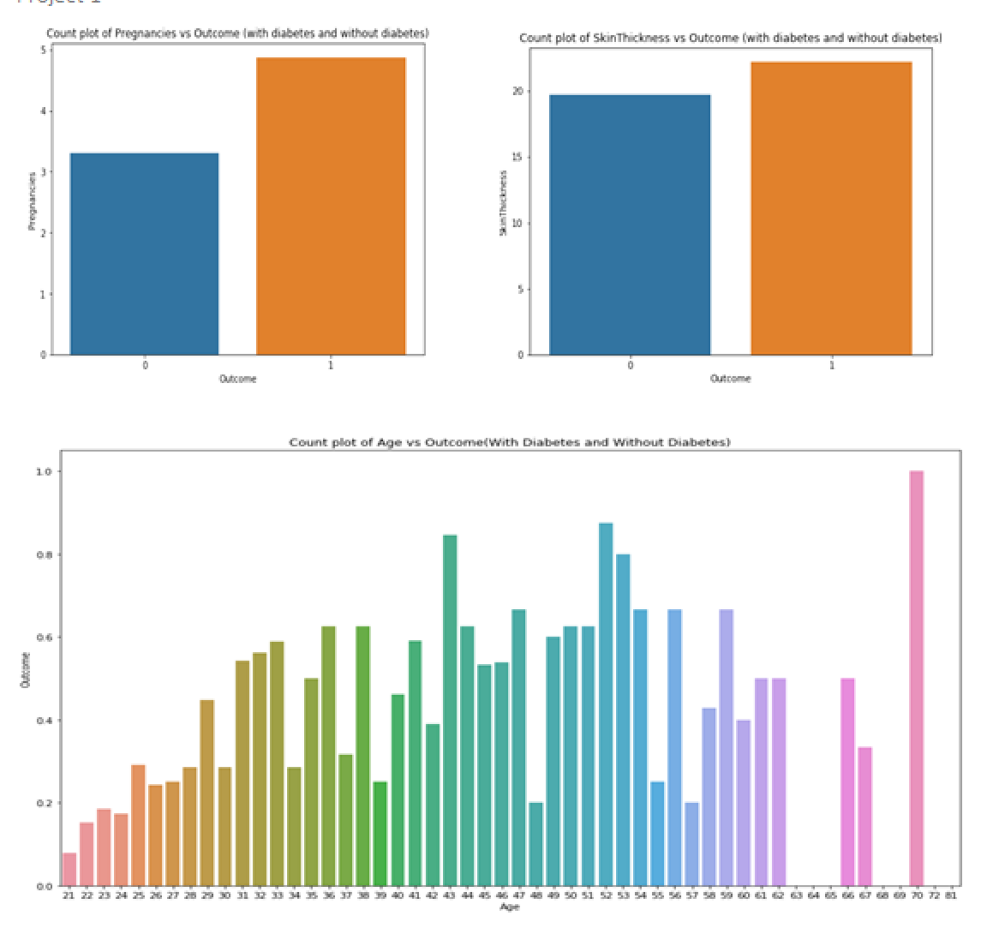
Data Understanding
Count plots of the features of the dataset with the target variables

Slide 12
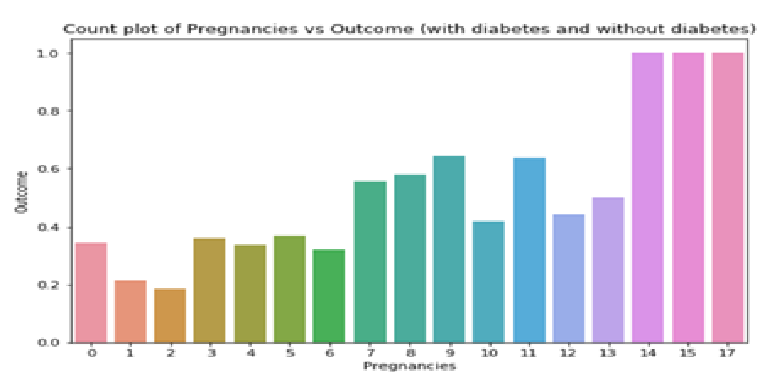
Data Understanding
Count plot of number of pregnancies and the target variable ‘Outcome’

Slide 13
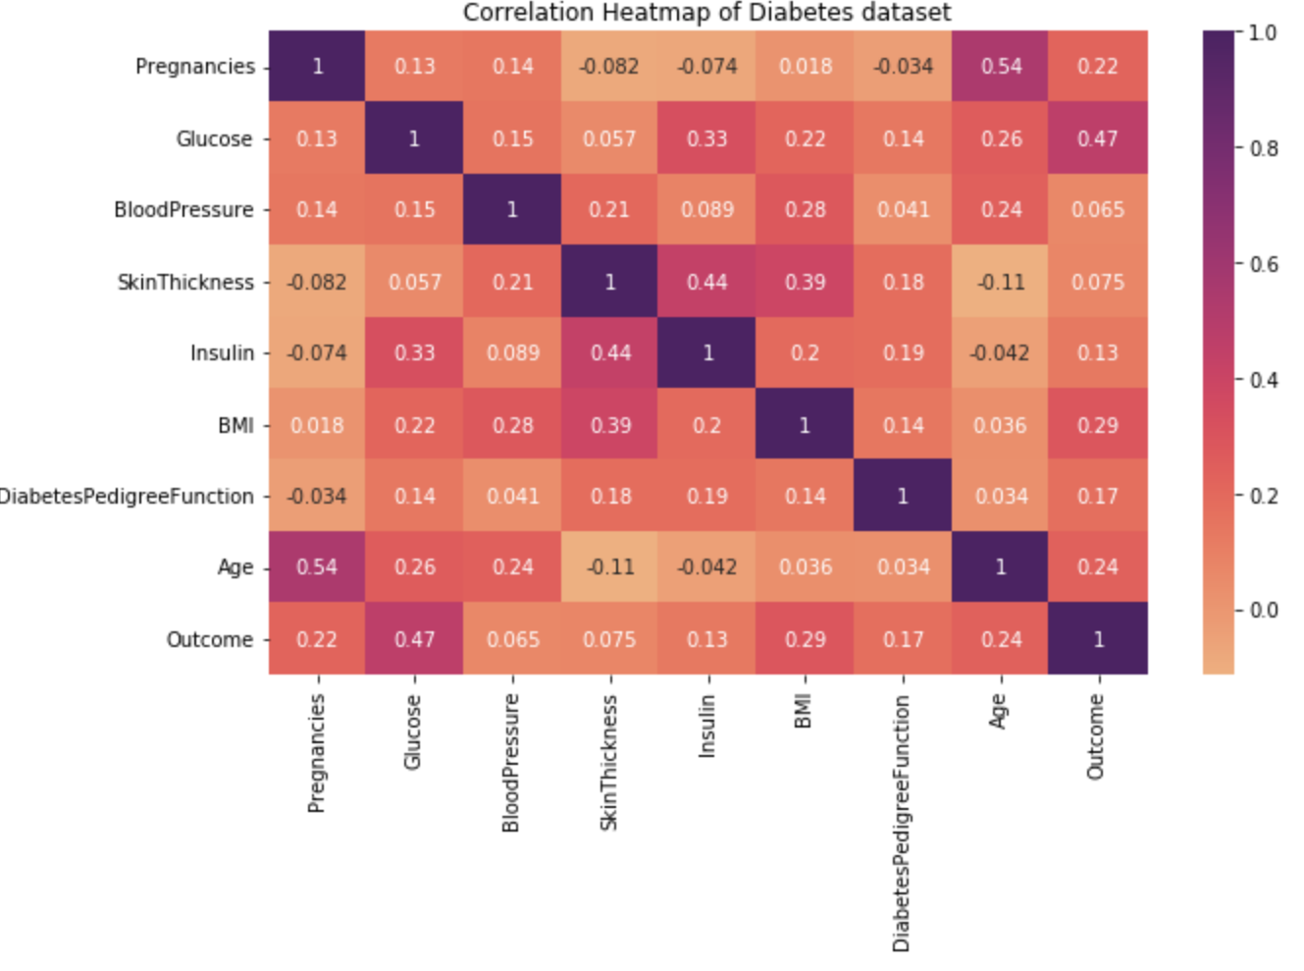
Data Understanding
Correlation Heatmap of Diabetes dataset.

Slide 14
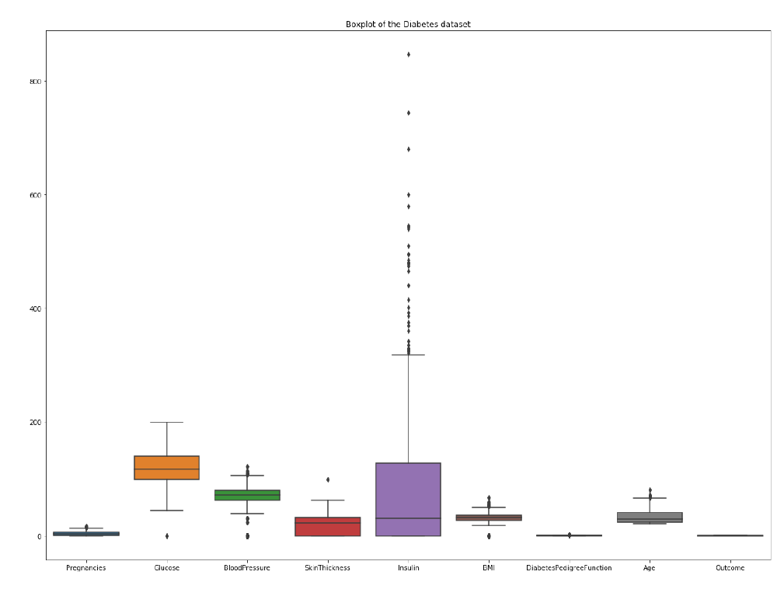
Data Preparation
Identification of the outliers using boxplot and removal of the outliers using Inter Quartile Range(IQR) method

Slide 15
Data Preparation
Split the dataset into ‘train’ and ‘test’ datasets.
Target variable - > ‘Outcome’
The dataset is split into 80% training dataset and 20% test dataset, taking the test size as 0.2 and the random_state as 42.
Principal Component Analysis (PCA) is applied and second set of train and test data sets are created, with this the features have been reduced from 8 to 7.
The features train and test datasets are standardized using StandardScaler function.
The X_train dataset is transformed and fit to the standardscaler and the X_test dataset is just transformed but not fit.
With this the data is ready for model building.

Slide 16
Modeling
The following models are selected for this project:
Logistic Regression model
K – Nearest Neighbor Classifier
Decision Tree Model
Support Vector Machine
All the four models are created and fit with the X_train and y_train datasets and PCA applied X train and Y train datasets respectively, predictions are created for the test dataset to evaluate the model’s performance.

Slide 17
Evaluation
Evaluation metrics used are as follows
Accuracy
Precision
Recall
F1 Score

Slide 18
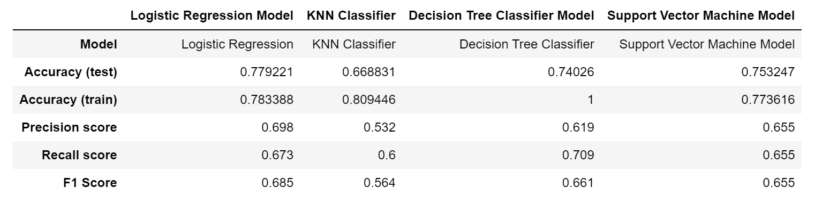
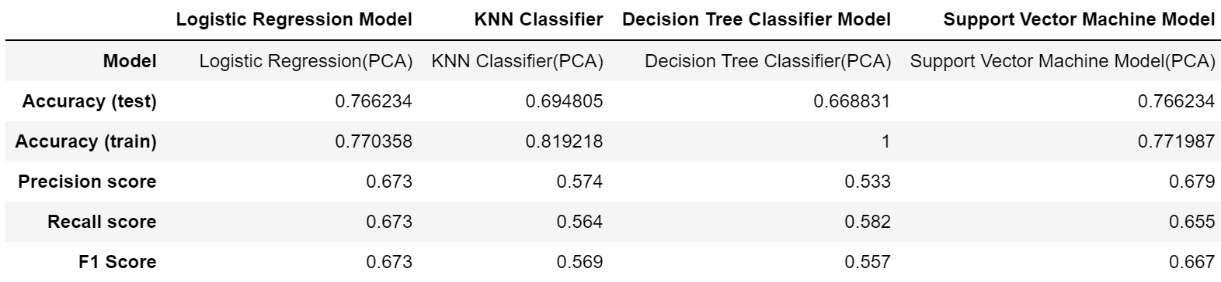
Evaluation
Evaluation metrics calculated for the original test data set and PCA applied test dataset.

Slide 19
Deployment
Though the Logistic Regression model and the Support Vector Machine models performed well with the features available in the dataset, the models are not recommended for deployment, as there are a lot of other features that are to be added to the dataset in prediction of Diabetes in Female patients like family history, diet, daily active hours, habit of smoking, habit of alcohol consumption etc. also play an important role in the prediction of Diabetes in female patients.
However the models can be tested with the real life data collected from the hospitals and helps understand the features that are having more influence in a female patient tested positive for diabetes.

Slide 20
Conclusion
There are several factors that can cause diabetes in the Female patients. From the above analysis we can conclude that the Logistic Regression Model and Support Vector Machine model performed well for the diabetes dataset and from the EDA we can say that the high values of the features Glucose, Insulin, BMI, and SkinThickness are more prone to be tested positive for diabetes.
The Female patients of age 40+ years , BMI Level above 30 , glucose levels above 120 are being tested positive for diabetes.
The female patients being pregnant for more times are also found to be tested positive for diabetics.

Slide 21
Ethical Considerations
Ethical considerations while dealing the data related to patients is not to misuse the data collected and misrepresentation of the facts that are collected. I have taken care to not to misuse the data related to the patients in the project analysis.

Slide 22
References
Kaggle.com, Diabetes dataset, https://www.kaggle.com/datasets/akshaydattatraykhare/diabetes-dataset
Hindawi, Prevalence, and Early Prediction of Diabetes Using Machine Learning in North Kashmir: A Case Study of District Bandipora, 29 August 2022, https://www.hindawi.com/journals/cin/2022/2789760/
Google, Machine learning and deep learning predictive models for type 2 diabetes: a systematic review, 20 December 2021, https://dmsjournal.biomedcentral.com/articles/10.1186/s13098-021-00767-9
https://www.singlecare.com/blog/diabetes-symptoms-women/
Google, diabetes, https://www.cdc.gov/diabetes/basics/diabetes.html#:~:text=Diabetes%20is%20a%20chronic%20(long,your%20pancreas%20to%20release%20insulin.
Google, Healthline, How Diabetes affects women, https://www.healthline.com/health/diabetes/symptoms-in-women#How-Diabetes-Affects-Women:-Symptoms,-Risks-And-More

Slide 23
Thank You

